Slide 1

PYTHON PROJECT
Moderator: Reza

Slide 2

AGENDA
INTRODUCTION TO DATA SET
EDA
PREPROCESSING
MODEL FITTING
MODEL EVALUATION
CONCLUSION

Slide 3

INTRODUCTION TO DATASET

Slide 4
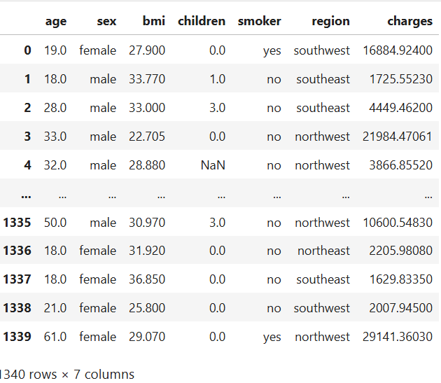
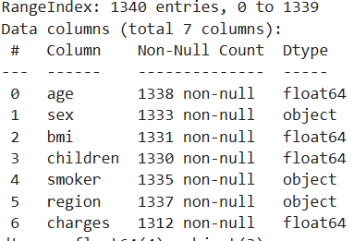
INTRODUCTION TO DATASET
1340 rows, 7 columns
4 Continuous columns and 3 Categorical columns
Missing values and Duplicates are handled

Slide 5

EXPLORATORY DATA ANALYSIS

Slide 6
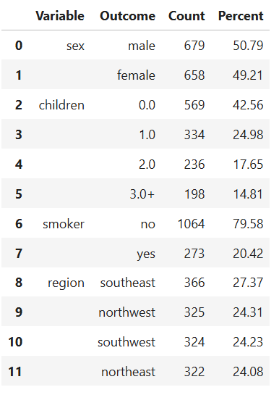
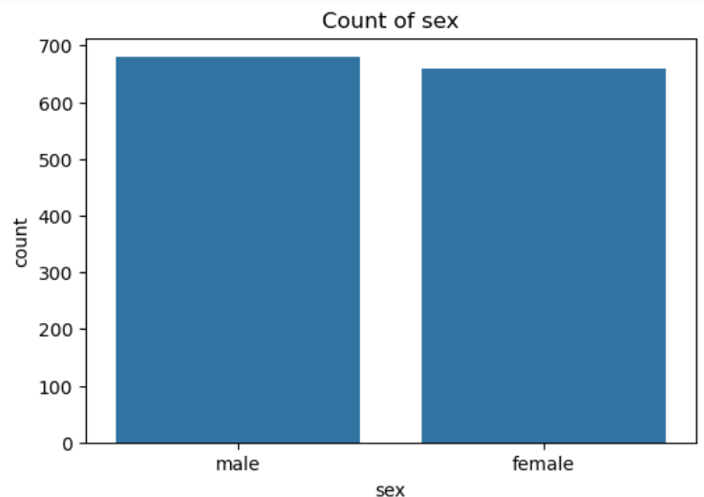
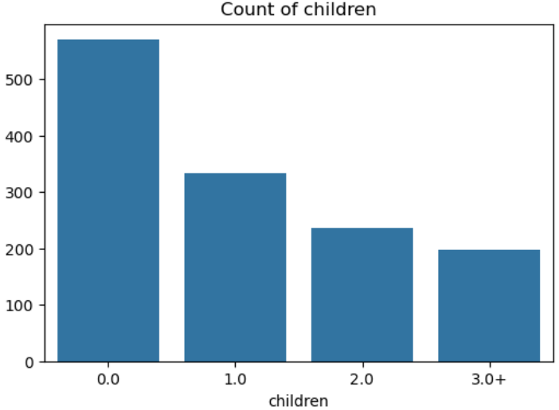
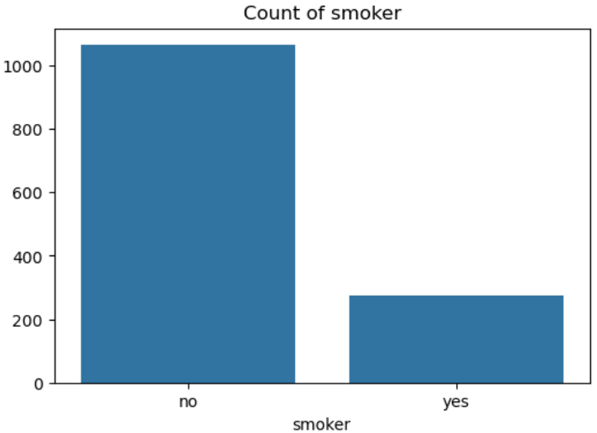
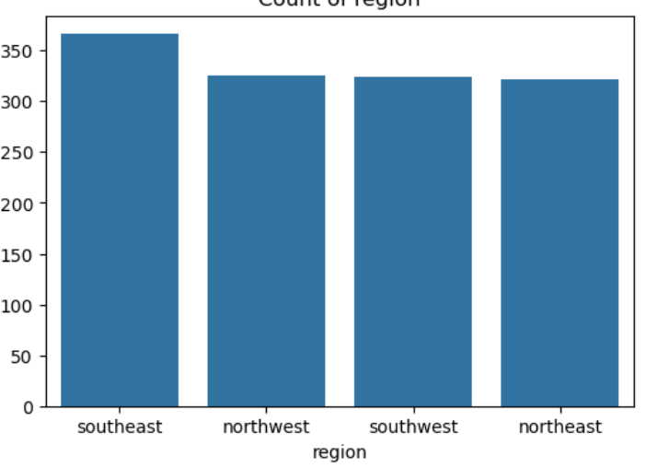
EDA– CATEGORICAL VARIABLE
Column Children has been transformed (3,4,5 are considered as one group 3+)

Slide 7
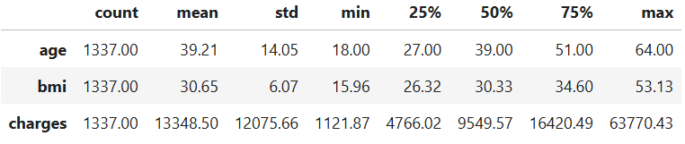
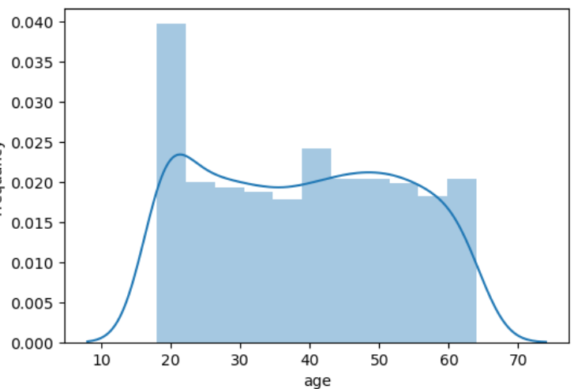
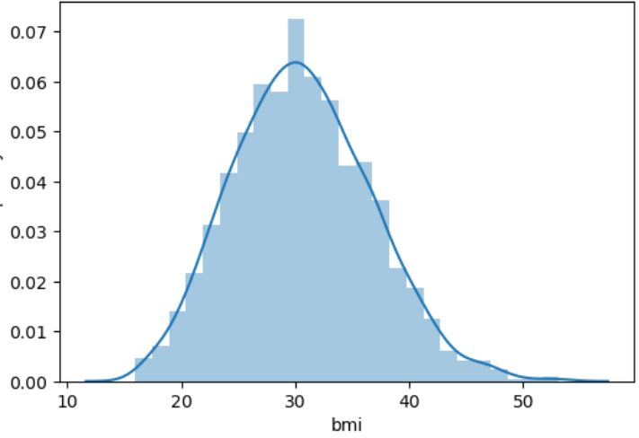
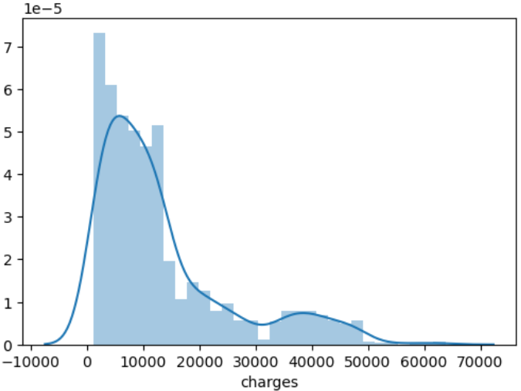
EDA – NUMERIC VARIABLE

Slide 8
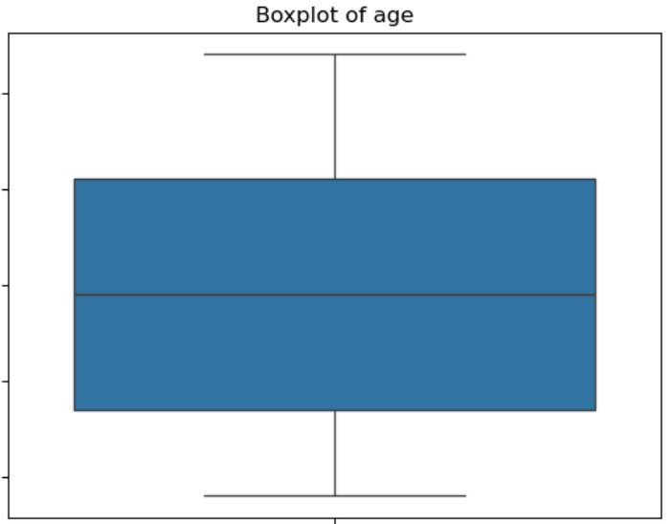
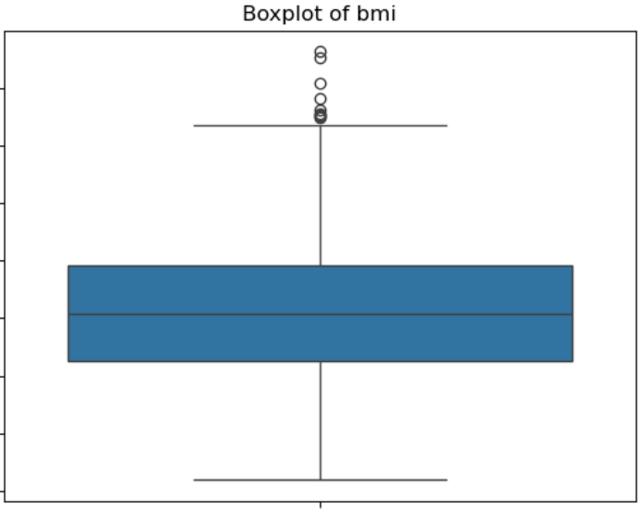
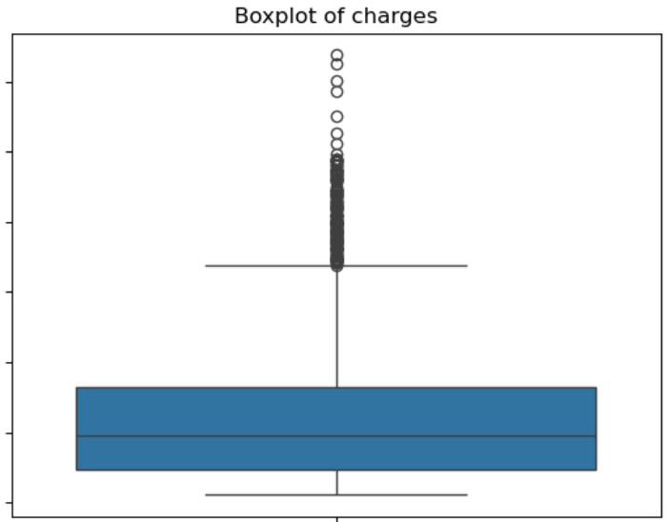
EDA – OUTLIER DETECTION
Turkey method detected 6 outliers only in charges column- which was handled by performing square root transformation

Slide 9
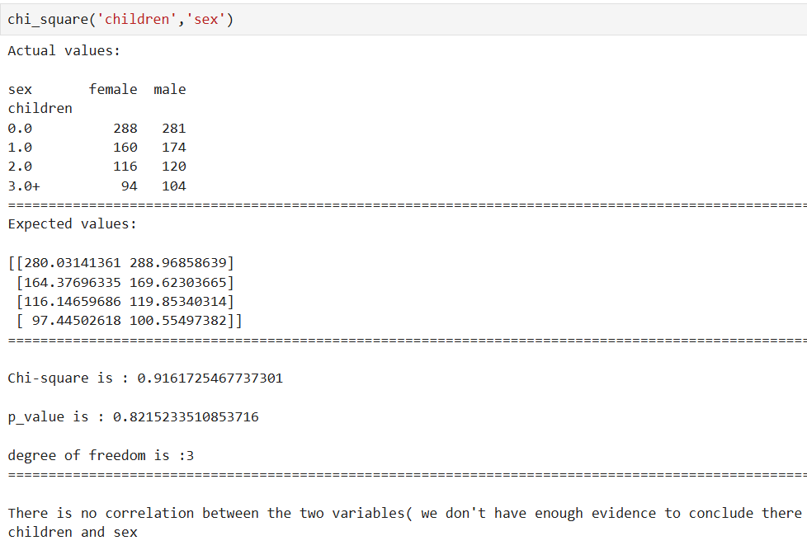
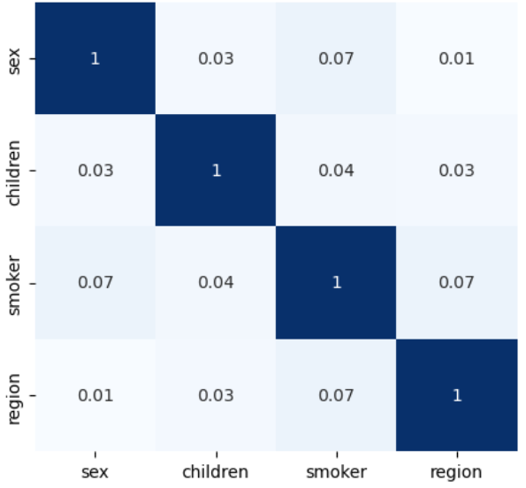
EDA- BIVARIATE ANALYSIS
CATEGORICAL VS CATEGORICAL

Slide 10
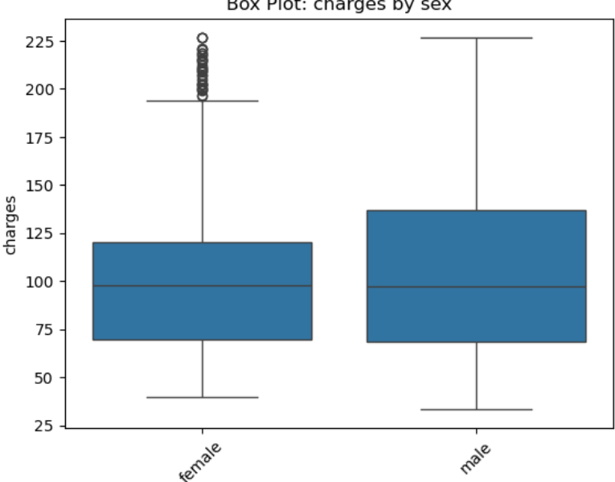
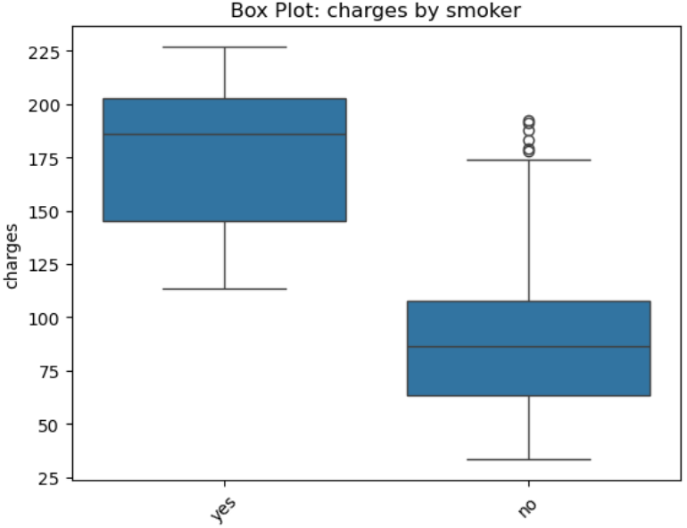
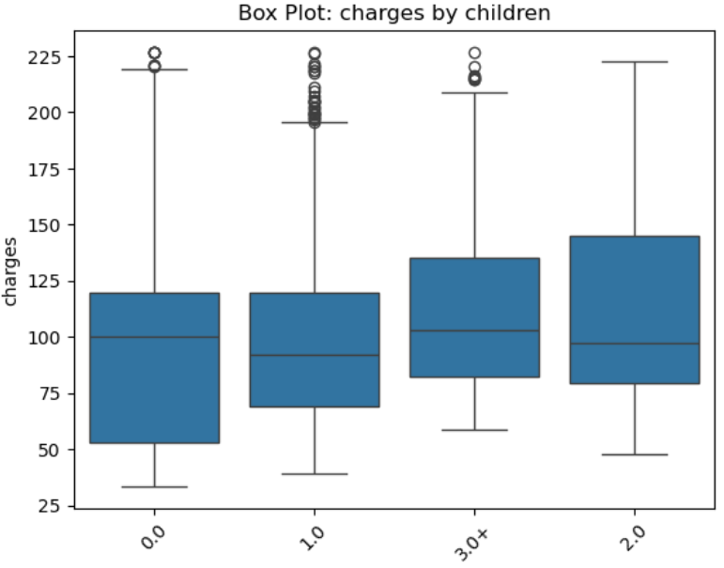
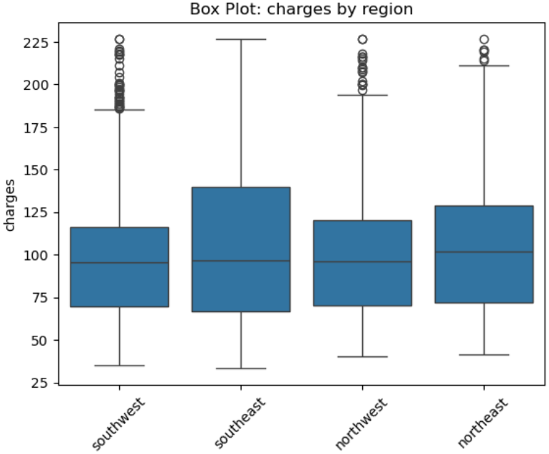
EDA- BIVARIATE ANALYSIS
CATEGORICAL VS CONTINOUS
Charges vs. Sex: No significant difference in mean values between groups.
Charges vs. Children: Significant difference in mean values between at least one group.
Charges vs. Smoker: Significant difference in mean values between at least one group.
Charges vs. Region: Significant difference in mean values between at least one group.

Slide 11
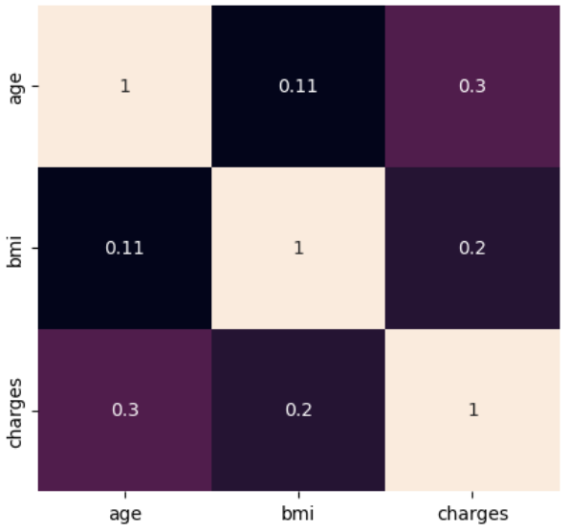
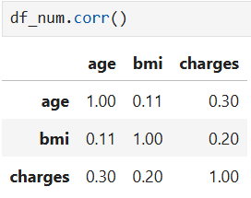
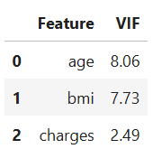
EDA- BIVARIATE ANALYSIS
CONTINOUS VS CONTINOUS :
- Correlation/Collinearity & multicollinearity

Slide 12
Data preprocessing

Slide 13

DATA PREPROCESSING
ONE HOT ENCODING
DATA SPLITING
SCALING

Slide 14
Model fitting

Slide 15
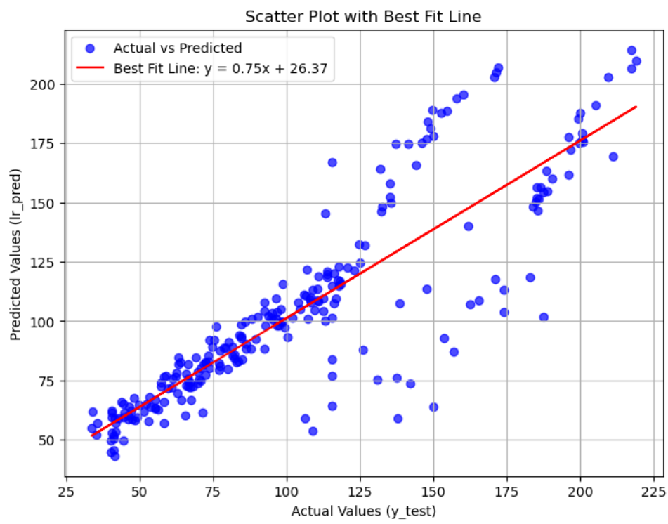
Model fitting
LINEAR REGRESSION:
(Baseline model)

Slide 16
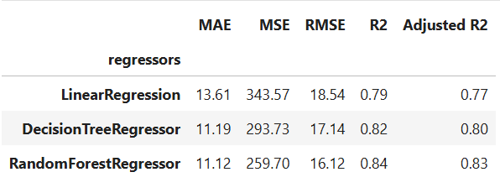
Model fitting
Linear Regression performed the worst due to its inability to capture non-linear relationships.
Decision Tree performs better than Linear Regression but falls short compared to the Random Forest.
Random Forest Regression performed the best with the lowest MAE, MSE and RMSE and the highest R² Score.
‘The Random Forest model is our recommended choice for predicting house prices, which have to be further tunneing.’

Slide 17
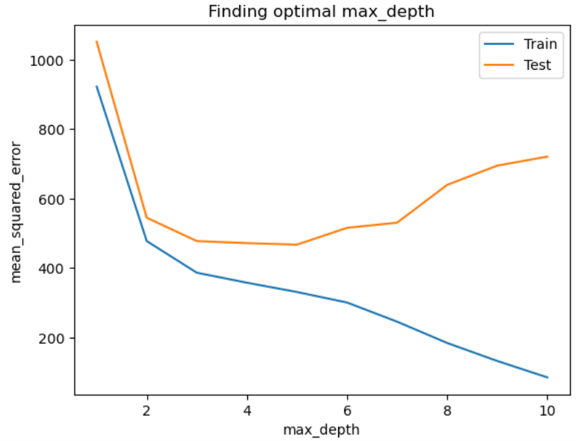
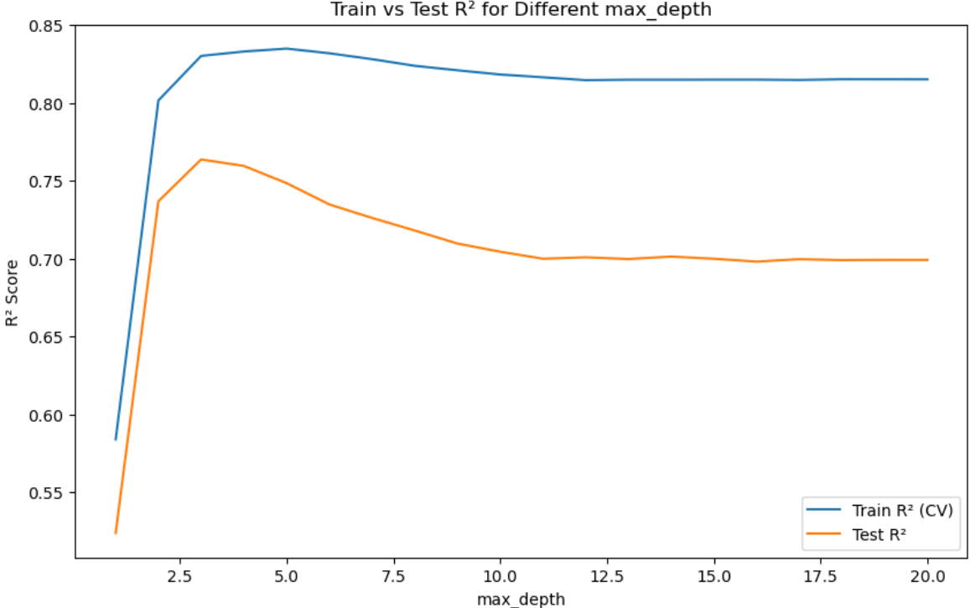
Hyperparameter tuning

Slide 18
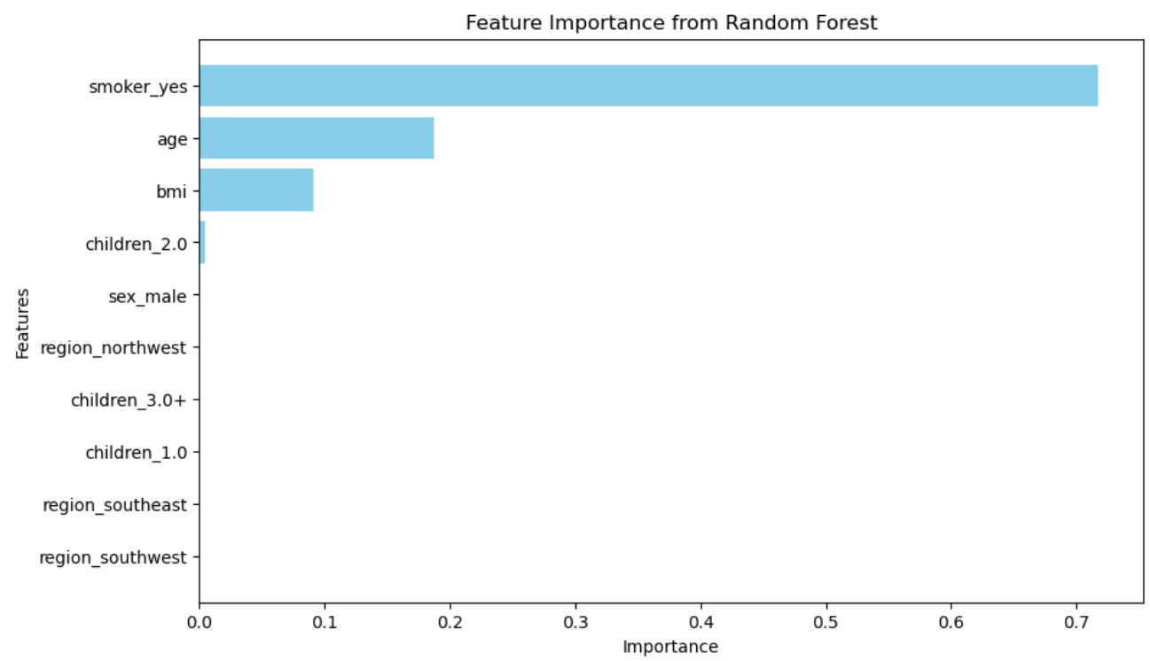
Feature importance

Slide 19
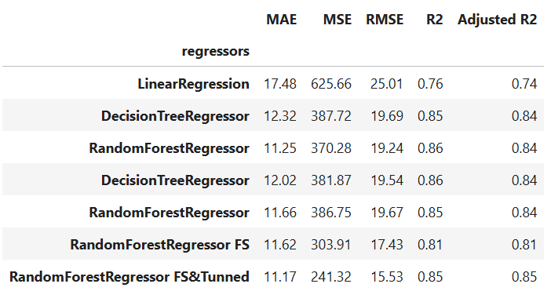
MODEL EVALUATION

Slide 20
MODEL EVALUATION

Slide 21
MODEL EVALUATION
RESULTS:
MAE: 13.04
MSE: 427.38
RMSE: 20.67
R² Score: 0.84
Adjusted R² Score: 0.83

Slide 22

THANK YOU
Naina Singamsetti

